Slide 1

Short Video Platform
(TikTok Clone – Design Patterns and Threads)
Department: CSE
Section: A3
Date: 7.1.2025

Slide 2
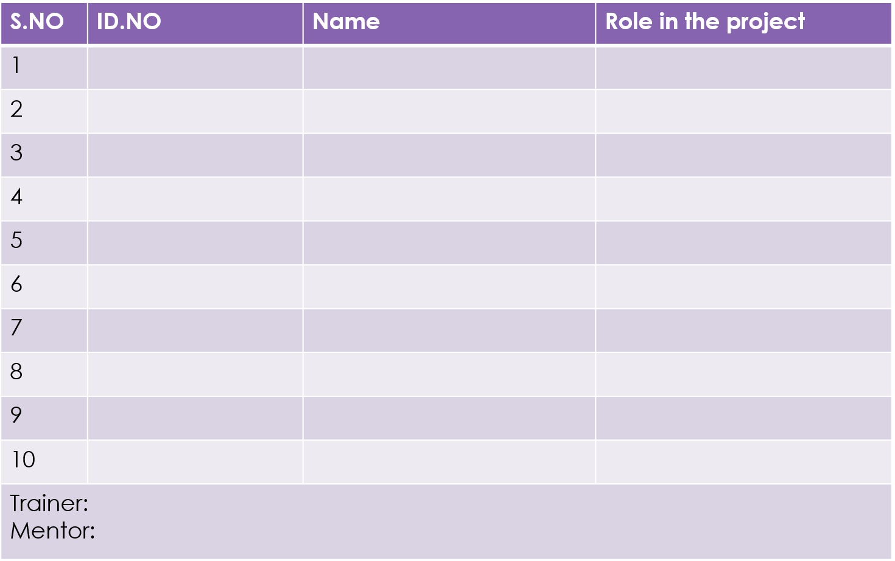
2310030044 Khushi
2310030046 S Nikhil
2310030041 S.Rajkumar
2310030001 Shayesta
K. Sashidar

Slide 3
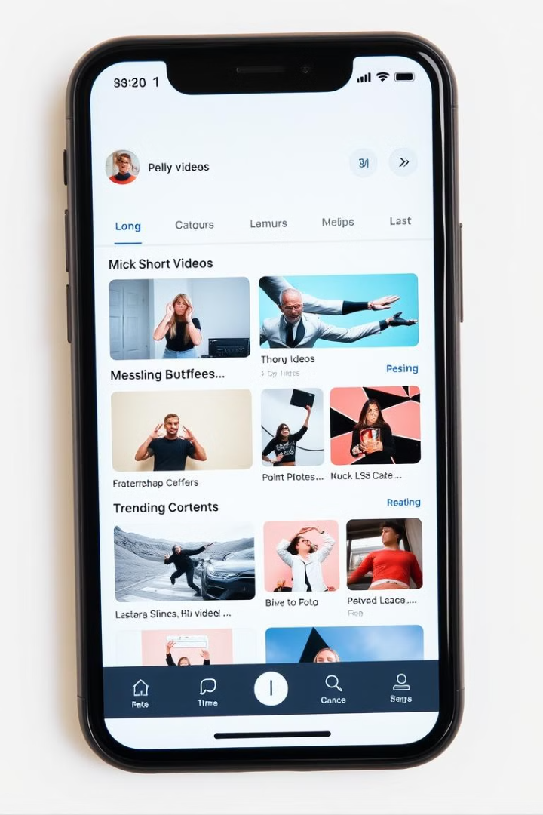
Key Features
Video Creation
Content Discovery
Users can easily record and edit short videos with filters, effects, and music.
A sophisticated recommendation algorithm suggests relevant videos based on user preferences.
Social Interaction
Live Streaming
Features like likes, comments, sharing, and direct messaging encourage engagement.
Live streaming capabilities enable real-time interaction and community building.
Notes:
4

Slide 4
Server Hardware
CPU: Multi-core processors (at least 4 cores) for handling multiple concurrent requests and video processing.
RAM: Minimum of 16 B of RAM for caching and smooth operations, especially with high traffic volumes.
Storage:
SSD storage for faster data retrieval.
Scalable cloud storage (e.g., AWS S3, Google Cloud Storage) for storing videos.
Network:
High-speed internet connection (minimum 1Gbps) for real-time video streaming and data transmission.
Load Balancers: To distribute user requests across multiple servers for load balancing and fault tolerance.
CDN (Content Delivery Network): Use global CDN services like Cloudflare or Akamai to reduce latency and deliver videos quickly to users worldwide
.
Notes:
5

Slide 5
Software Requirements:
Frontend:
React.js is used to build the web frontend for responsive user interfaces, while React Native or Flutter enables mobile apps for iOS and Android.
Redux is employed for state management, especially for user data and video feeds, while Axios handles API requests.
WebSocket is used to implement real-time notifications, likes, comments, and video streaming features.
Backend: The backend can be built using Node.js with Express for scalability and performance or Python (Django) for rapid development.
Java (Spring Boot) is another robust option for high-performance enterprise applications.
WebSocket ensures real-time interactions, and Redis is used for caching and managing session data, providing faster response times.
Notes:
5

Slide 6
Database:
MySQL or PostgreSQL are used for structured data like user profiles, video metadata, and interactions.
MongoDB is used for NoSQL storage, handling dynamic content such as comments and user activity logs.
Redis is utilized for caching frequently accessed data (e.g., video feeds, user interactions) and maintaining real-time data consistency.
Video Processing:
Video Encoding: FFmpeg for encoding/compressing videos and generating thumbnails, with cloud services like AWS Lambda for scalable processing.
Video Storage: Cloud storage (AWS S3, Google Cloud Storage) for secure, scalable, and redundant video file storage with high availability.
Notes:
5

Slide 7
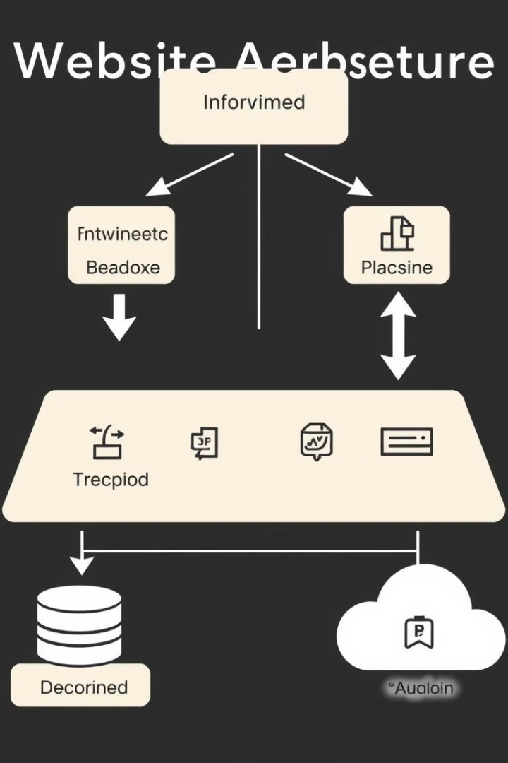



Technical Components
Database
Cloud Services
Stores user data, video metadata, and user interactions.
Leverages cloud infrastructure for scalability, storage, and content delivery.
Network Infrastructure
High-bandwidth network to ensure smooth video streaming and user interaction.
Notes:
6

Slide 8
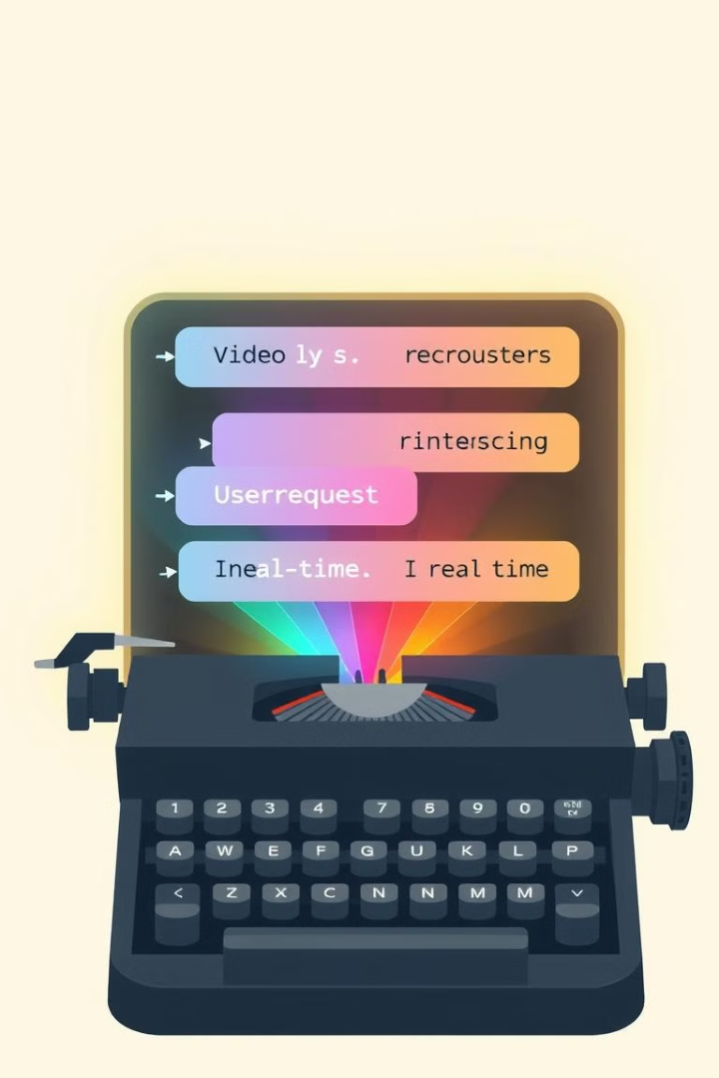
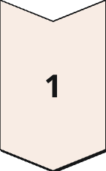
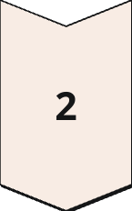
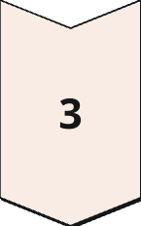
Threads and Concurrency
Video Encoding
Multiple threads can encode videos simultaneously, reducing processing time.
User Requests
Threads handle user requests concurrently, enhancing platform responsiveness.
Real-time Updates
Threads enable real-time updates for live streaming and notifications.
Notes:
8

Slide 9
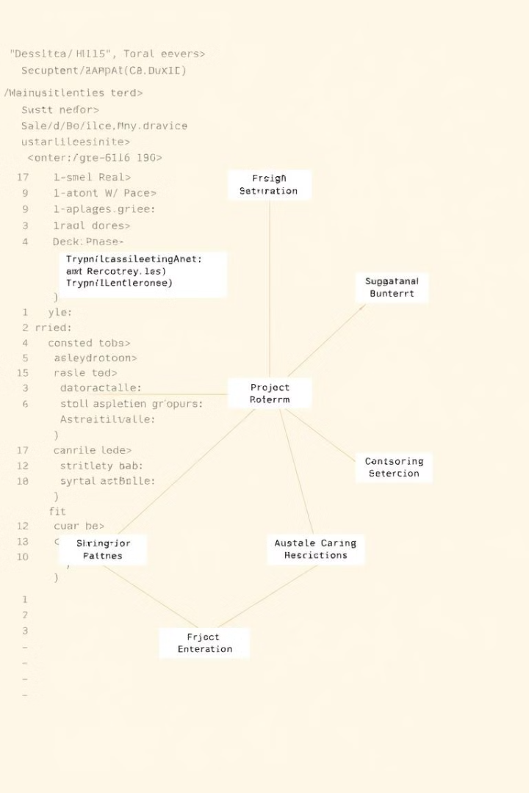
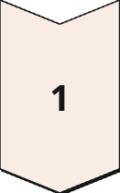
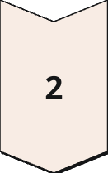
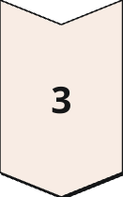
Design Patterns and Threading Concepts for Optimal Performance
Model-View-Controller (MVC)
Separating application logic, data, and user interface to improve maintainability and scalability.
Threading
Utilizing multiple threads to handle concurrent operations, such as video processing, user interactions, and notifications.
Asynchronous Programming
Employing asynchronous programming techniques to improve responsiveness and prevent blocking operations.
Notes:
7

Slide 10
Design Pattern Used In a TikTok clone:
Factory Pattern: Creates objects dynamically without specifying the exact class (e.g., for creating different video types).
Observer Pattern: Allows objects to be notified about state changes (e.g., notifications when a user likes a video).
Strategy Pattern: Defines interchangeable algorithms (e.g., for sorting video feeds based on different criteria).
Decorator Pattern: Adds new functionality to an object dynamically (e.g., adding filters or effects to videos).
Command Pattern: Encapsulates actions as objects, enabling queueing or undoing of operations (e.g., liking, commenting).
Proxy Pattern: Provides controlled access to another object (e.g., controlling video streaming or storage access).
Adapter Pattern: Converts one interface to another to ensure compatibility (e.g., integrating third-party video services).
Facade Pattern: Simplifies complex subsystems by providing a unified interface (e.g., simplifying video upload, encoding, and storage processes).
Singleton Pattern: Ensures a class has only one instance (e.g., for database connections or cache management).

Slide 11
Thread Used in a TikTok clone:
Video Upload Thread: Handles asynchronous video uploads to avoid blocking the main UI.
Video Streaming Thread: Manages smooth video streaming by processing video data in the background.
Real-Time Interaction Thread: Manages real-time user actions like likes, comments, and notifications.
Feed Generation Thread: Fetches and updates personalized video feeds in the background.
Push Notification Thread: Sends real-time notifications for user interactions (e.g., likes, follows).
Background Processing Thread: Handles tasks like transcoding and syncing data without blocking UI.
Database Query Thread: Executes database queries asynchronously to ensure UI responsiveness.

